Slide 1
Counting

Slide 2
Factorial
n! is represented as n * ( n – 1) * ( n -2 ) ….. * 3 * 2 * 1
n! is also written as n * ( n – 1 )!
1! is 1
0! is 1 too

Slide 3
Combinatorial analysis
includes counting, permutations and combinations.
How to calculate all possibilities without counting them.

Slide 4
Counting – Two ways
Sum Rule Principle
Product Rule Principle
Event A can occur in m ways and event B can occur in n ways, then Event A or Event B can occur in m + n ways.
A dice is rolled, #4 occurs in 1 way. #6 occurs in 1 way. Then 4 or 6 can occur in two ways.

Slide 5
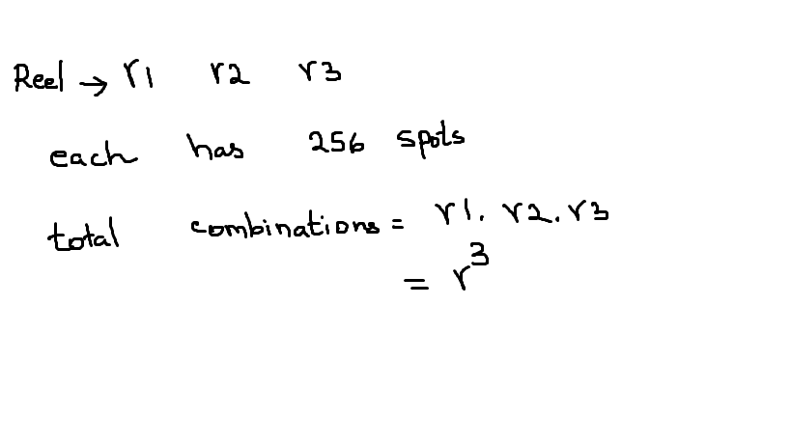
Problem 1: Slot Machines with three reels
A slot machine with three reels are very popular in Reno and Vegas.
A reel may have 256 spots.
That would make 256*256*256 = 16 Millions positions [ product rule]
Odds of a jackpot may occur one in 16 million.
Here repeats allowed

Slide 6
CA License Plate problem – replacement is allowed
The California license plate has this format [ at least in my car ]:
digit [1-9] Letter Letter Letter digit [ 0 – 9 ] digit [ 0 – 9 ] digit [ 0 – 9 ]
The total number of plates to be printed is:
The product rule applies: 9 * 26 * 26 * 26 * 10 * 10 * 10 = 156 Million
26 million currently registered in CA

Slide 7
License Plate problem – Without digits
The Generic license plate with 6 letters A-Z will have this format :
Letter Letter Letter Letter Letter Letter
The product rule applies: 26 * 26 * 26 * 26 * 26 * 26 = 26 ⁶
Here replacement is allowed

Slide 8
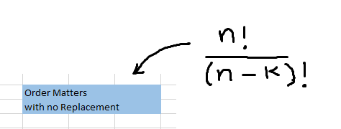
Permutations with no replacement

Slide 9
Permutations – Order important, No repeats
In how many ways can we choose m objects from n objects.
Say there are 8 people , and Award Gold, Silver and Bronze medals to three people.
There is only one Gold, One Silver, and one Bronze Medalist.
There are no repetitions, no replacements. A cannot win gold and silver at the same time.
Order is important
The total possibilities are : 8 ways to choose a gold medalist, ( 8 – 1 ) ways to choose silver and ( 8 – 2 ) ways to select a bronze.
This is expressed as : n * ( n – 1 ) * ( n -2 ) .

Slide 10

Permutations – Order important, No repeats

Slide 11
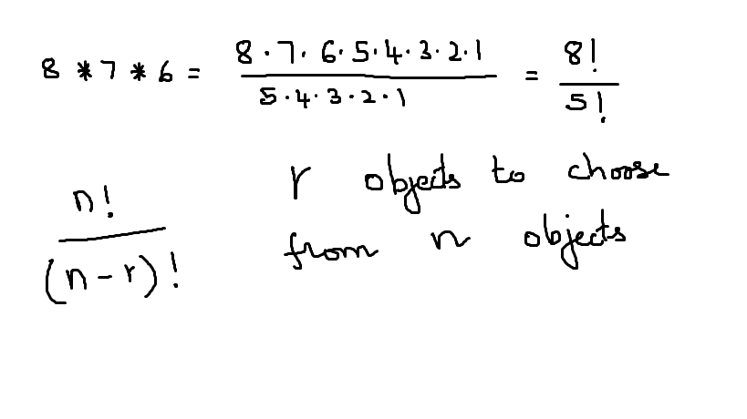
Permutations – Order important, No replacement
This could be expressed as :

Slide 12
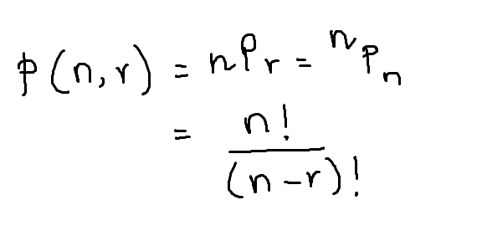
Permutations – Order important, No repeats

Slide 13
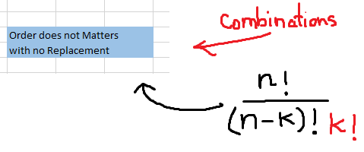
Combinations - Order does not matters

Slide 14
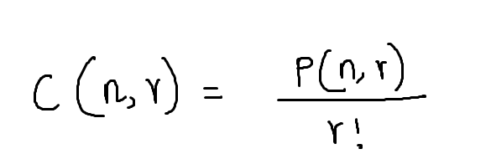
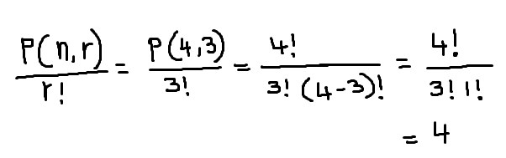
Combinations – order doesn't matter
Three students getting A grades from a class of 4 students: A, B, C, D
ABC, ACD, ABD, BCD
This is represented as :

Slide 15
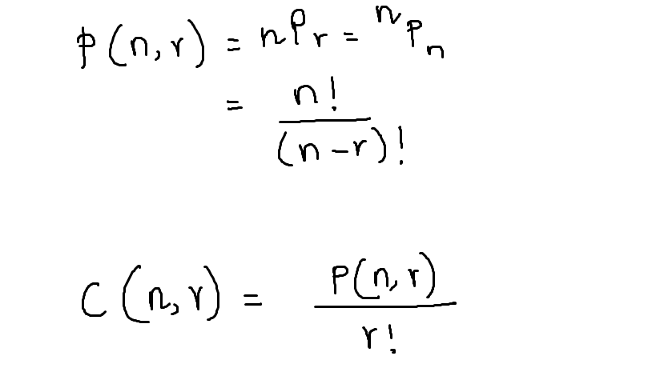

Slide 16
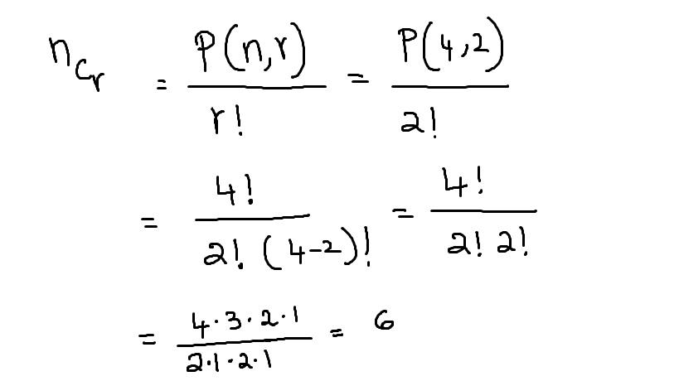
A department offers 4 graduate level courses: A, B, C and D.
A student requires two courses to graduate. How many combinations are possible?

Slide 17
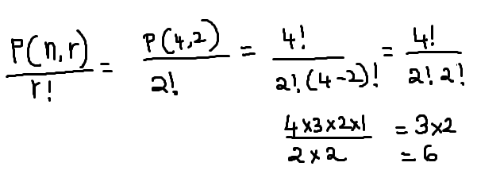
A department offers 4 graduate level courses: A, B, C and D.
A student requires two courses to graduate. How many combinations are possible?
AB, AC, AD, BC, BD, CD are possible courses .
BA and AB counts as one because order is not important.

Slide 18
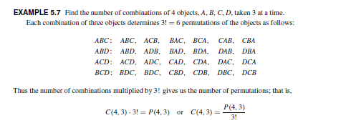

Slide 19
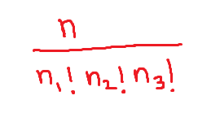
Last topic: Permutations with indistinguishable objects
The number of different permutations of n objects where there are n1 indistinguishable objects of type 1, n2 of type 2, n3 of type 3 is:

Slide 20
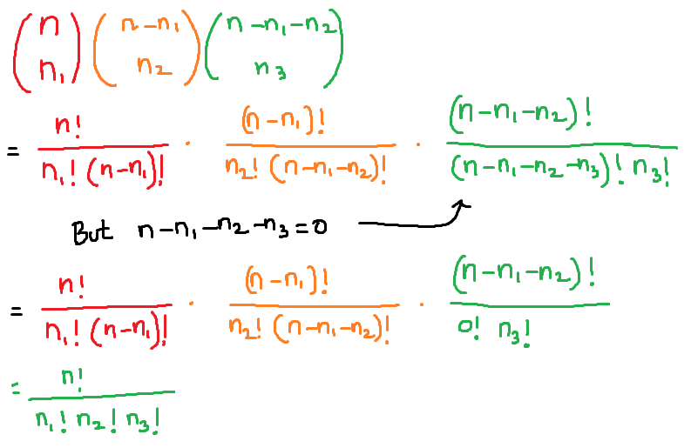
Proof: Permutations with indistinguishable objects

Slide 21
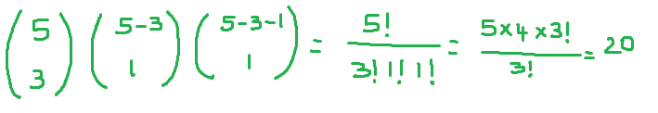
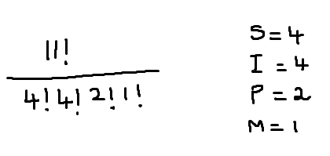
BABBY
MISSISSIPPI

